Slide 1
Galileo and the Celestial Phenomena
Post-visit
In-depth materials
(High schools, age 14-18)

Slide 2
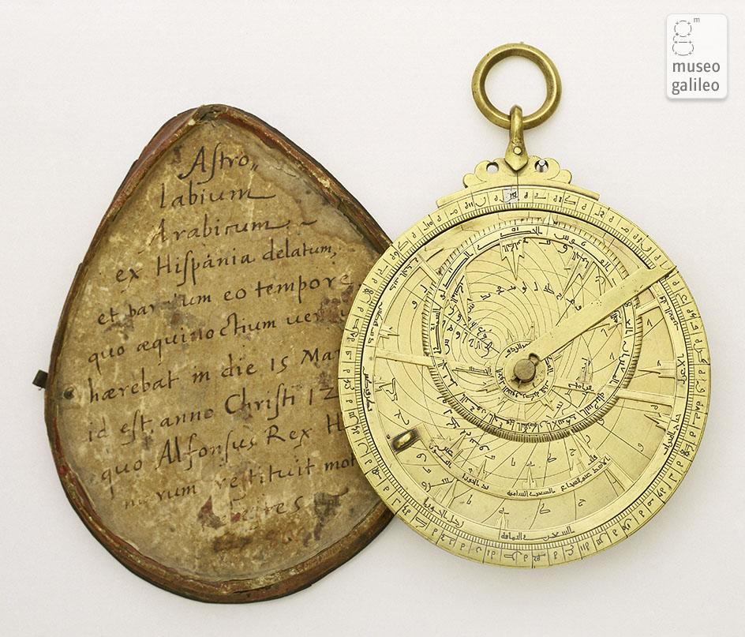
Measuring Time by Night: Astrolabes and Nocturnals
Highly versatile instruments, astrolabes could also be used to tell the time by day or by night, based on direct measurement of the height of the Sun or of a star.
Astrolabes had been developed to the highest levels by medieval Islamic astronomers. In the 16th century, devices of European design were produced for measuring time by night.
Nocturnals, for instance, determined the hour by the position of the last two stars in the Big Dipper in relation to the Pole Star. These instruments were useless when the sky was overcast.
Plane astrolabe. Museo Galileo, Florence
Notes:
IN-DEPTH
https://catalogue.museogalileo.it/section/MeasuringTimeByNightAstrolabesNocturnals.html

Slide 3
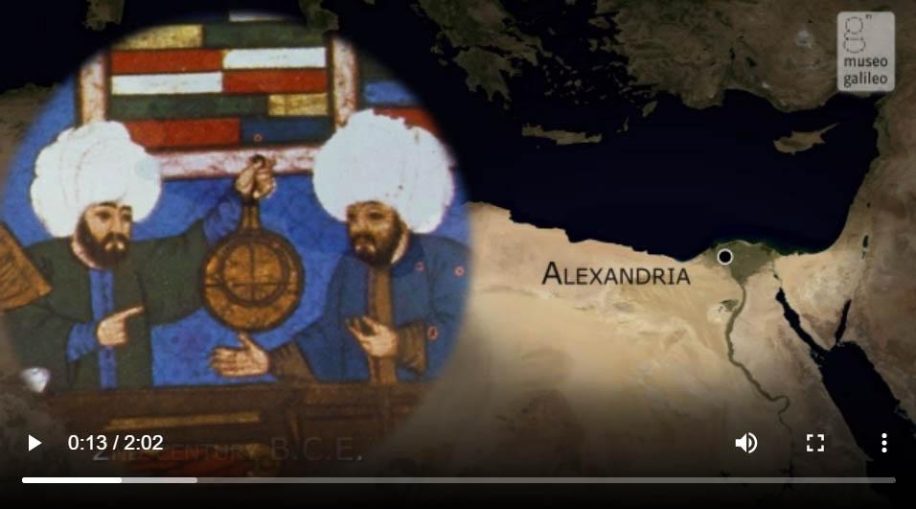
Astronomical use of the plane astrolabe
The planispheric astrolabe is the most versatile instrument made in antiquity for the analogical performance of astronomical computations.
Watch the video
Notes:
IN-DEPTH
The video, its text transcription and some related instruments are available at https://catalogue.museogalileo.it/multimedia/AstronomicalUsePlaneAstrolabe.html

Slide 4
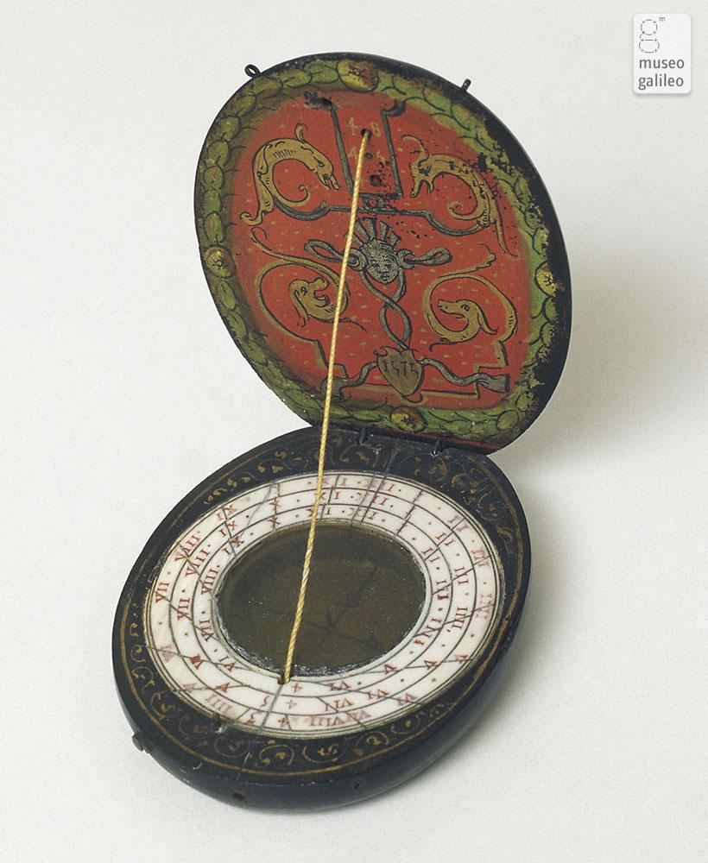
Measuring Time by Day: Sundials
The first chronometric instruments were based on the changing direction and length of shadows cast by objects exposed to sunlight. The shadow of an indicator (called style or gnomon) falling on a set of hour lines showed the time. Alternatively, the Sun's height above the horizon could be measured directly .
Thanks to the mastery of projective geometry, by the 16th century instrument makers were producing many different kinds of sundials - instruments that could be suspended from a hook, placed on shelves or mounted on walls, as well as pocket instruments. Some of these are still in use today.
Diptych dial. Museo Galileo, Florence
Notes:
IN-DEPTH
https://catalogue.museogalileo.it/section/MeasuringTimeByDaySundials.html

Slide 5
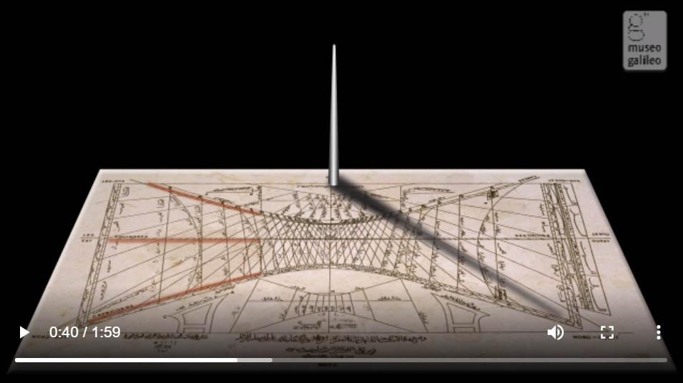
Sundials
Sundials are instruments based on the principle of a rod casting a shadow on a quadrant and were used to determine the time of the day.
Watch the video
Notes:
IN-DEPTH
The video, its text transcription and some related instruments are available at https://catalogue.museogalileo.it/multimedia/Sundials2.html
Read more at https://catalogue.museogalileo.it/indepth/Sundial.html

Slide 6
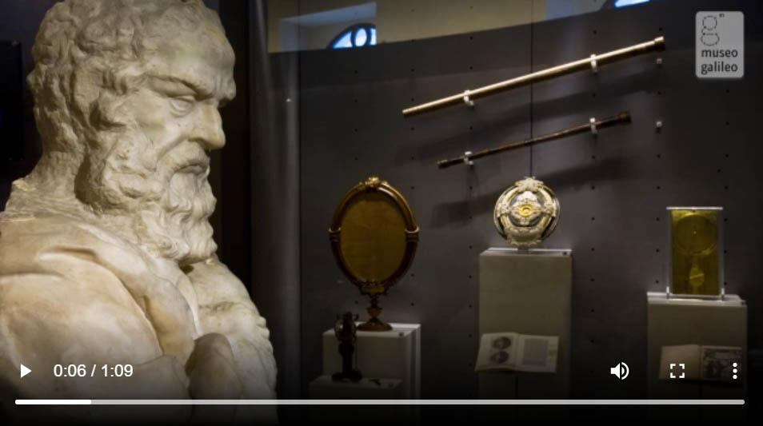
Galileo’s New World
In the Museo Galileo are displayed the only two surviving telescopes built by pisan scientist, together with other instruments of his invention.
Watch the video
Notes:
IN-DEPTH
The video, its text transcription and some related instruments are available at https://catalogue.museogalileo.it/room/RoomVII.html

Slide 7
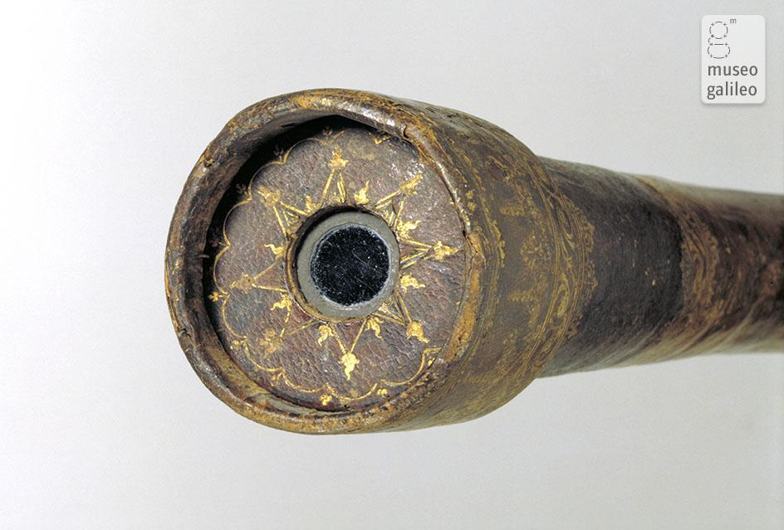
The Telescope: Observing and Measuring Astronomical Phenomena
Although the first "spyglasses" were fabricated in Holland in the early 17th century, Galileo alone immediately realized their great astronomical potential. Using two lenses, a plane-convex objective and a plane-concave eyepiece, he perfected the telescope, improving it to a magnifying power of 20 and designing accessories that made it not only an observation instrument but also a device for measuring astronomical phenomena.
Galileo's telescope. Museo Galileo, Florence
Notes:
IN-DEPTH
Read more at https://catalogue.museogalileo.it/section/TelescopeObservingMeasuringAstronomicalPhenomena.html
See Galileo’s telescopes at https://catalogue.museogalileo.it/object/GalileosTelescope.html and https://catalogue.museogalileo.it/object/GalileosTelescope_n01.html

Slide 8
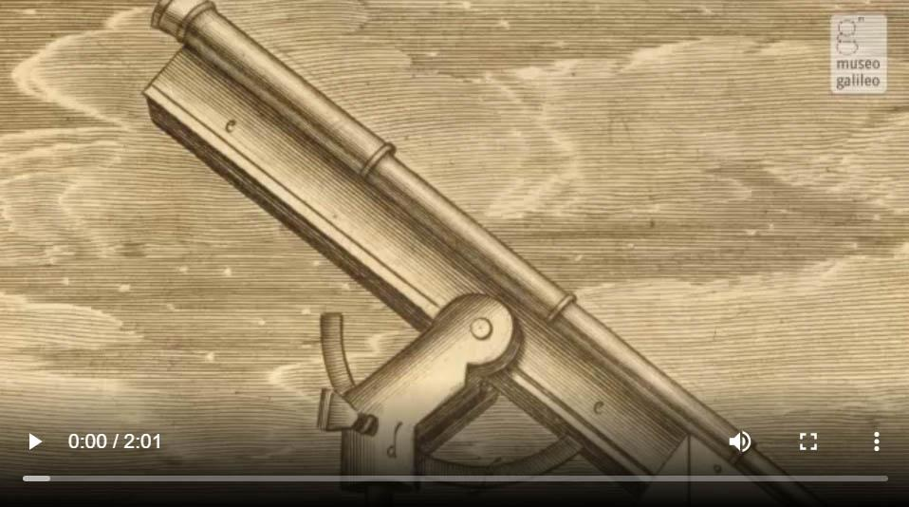
Telescope
The first rudimentary telescope was invented in Holland. Galileo saw a few copies of it in Venice.
Watch the video
Notes:
IN-DEPTH
The video, its text transcription and some related instruments are available at https://catalogue.museogalileo.it/multimedia/Telescope.html

Slide 9
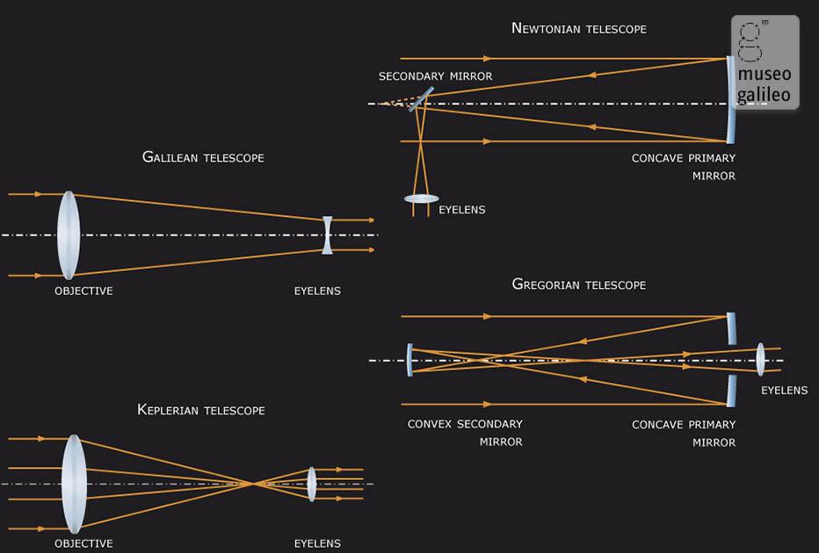
Telescope
Notes:
IN-DEPTH
https://catalogue.museogalileo.it/indepth/Telescope.html

Slide 10
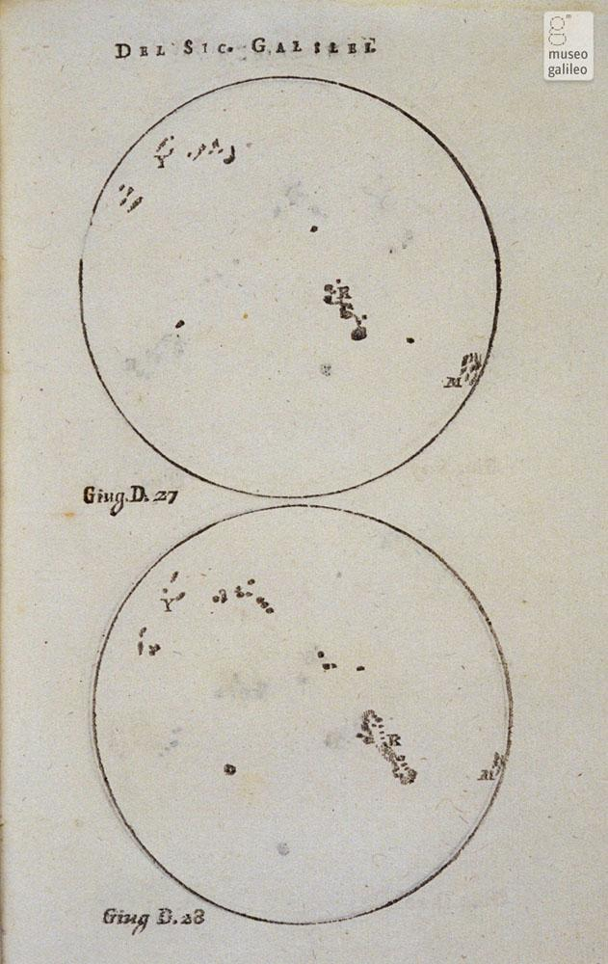
Sunspots
Sunspots were first observed by Galileo in 1610. He believed they were flat clouds stuck to the Sun's surface.
The discovery of sunspots challenged the ancient notion of the Sun as a perfect celestial body.
Galileo Galilei, Istoria e Dimostrazioni intorno alle macchie solari e loro accidenti. Sunspots observed by Galileo Galilei on 27 and 28 June 1612
Notes:
IN-DEPTH
https://catalogue.museogalileo.it/indepth/Sunspots.html
On Galileo’s work Istoria e dimostrazioni intorno alle macchie solari e loro accidenti [History and demonstrations concerning sunspots and their properties] read more at https://www.museogalileo.it/en/museum/explore/meet-galileo/38-works/466-istoria-e-dimostrazioni-intorno-alle-macchie-solari-1613.html and in https://brunelleschi.imss.fi.it/itineraries/pdf/GalileoBiography.pdf

Slide 11
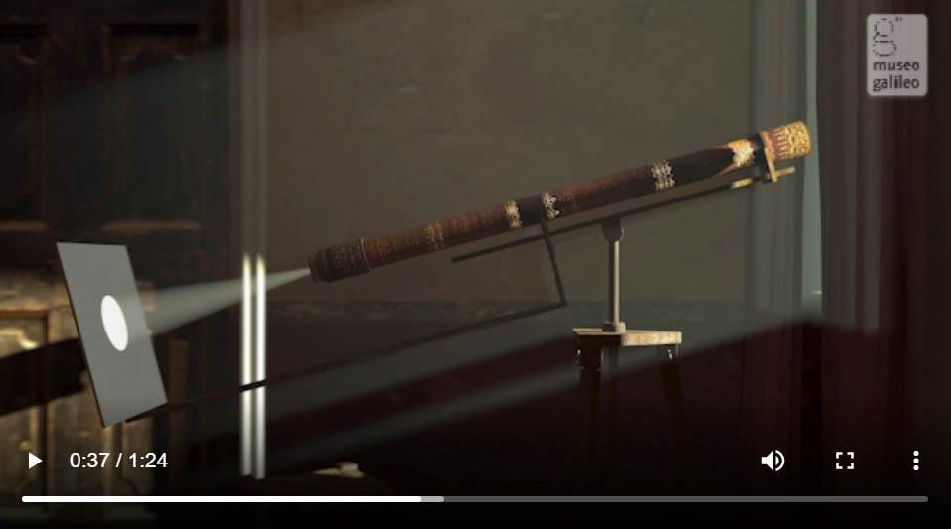
Helioscope
Galileo used the helioscope to observe the Sun without damaging his eyes.
Watch the video
Notes:
IN-DEPTH
The video, its text transcription and some related instruments are available at https://catalogue.museogalileo.it/multimedia/Helioscope.html

Slide 12
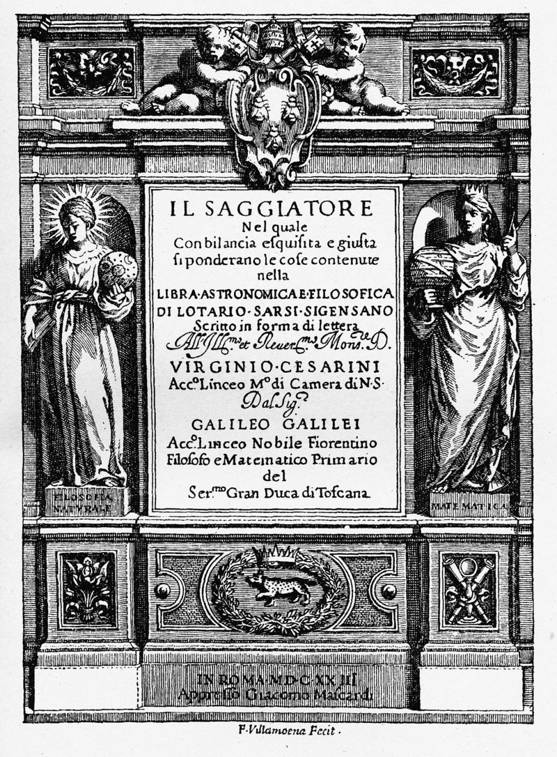
Galileo and the Aurora Borealis
Many do not know that the phenomenon of the northern lights is amongst Galileo’s celestial observations. In some parts of his work titled “Il Saggiatore” [The Assayer] which focused on the theme of comets discussed with Jesuit priest Orazio Grassi Galileo writes about “… vapors that represent the unexpected aurora borealis that light up sometimes presenting themselves to us as a bright cloud...” Galileo himself found the word “aurora borealis,” to evoke the name of the Greek goddess of the dawn, Aurora, and the god of the north wind, Borea.
Galileo Galilei, Il Saggiatore, 1623. Frontispiece
Notes:
IN-DEPTH
Read the passage from Il Saggiatore [The Assayer] at https://bibdig.museogalileo.it/Teca/Viewer?an=354802&pag=282&lang=it&q=aurora
Read more about Il Saggiatore at https://www.museogalileo.it/en/museum/explore/meet-galileo/38-works/468-il-saggiatore-1623.html and in https://brunelleschi.imss.fi.it/itineraries/pdf/GalileoBiography.pdf

Slide 13
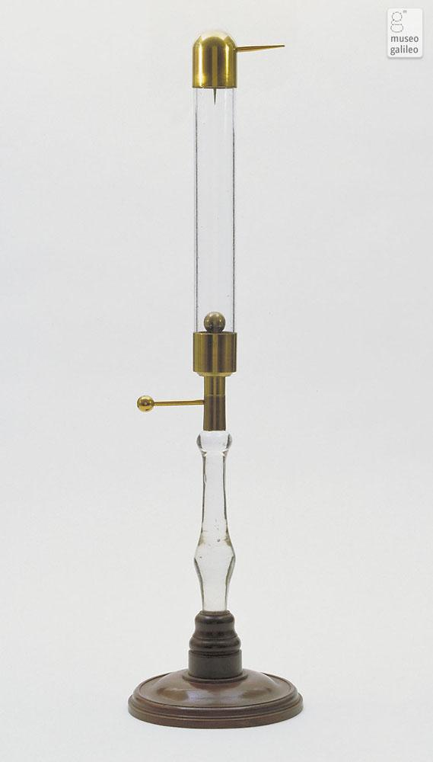
A “portable” aurora
The aurora borealis is produced by the charged particles from the Sun carried by the solar wind that are diverted from the terrestrial magnetic field and collide with gas molecules in the atmosphere.
By the end of the 18th century scientists tried to “reproduce” the phenomenon to better understand its origins using static electricity machines like those belonging to the Lorraine family collection found on Museo Galileo’s second floor: aurora tubes and flasks.
Aurora tube, 18th cent. Museo Galileo, Florence
Notes:
IN-DEPTH
More at https://catalogue.museogalileo.it/object/AuroraTube.html and https://catalogue.museogalileo.it/object/AuroraFlask.html

Slide 14
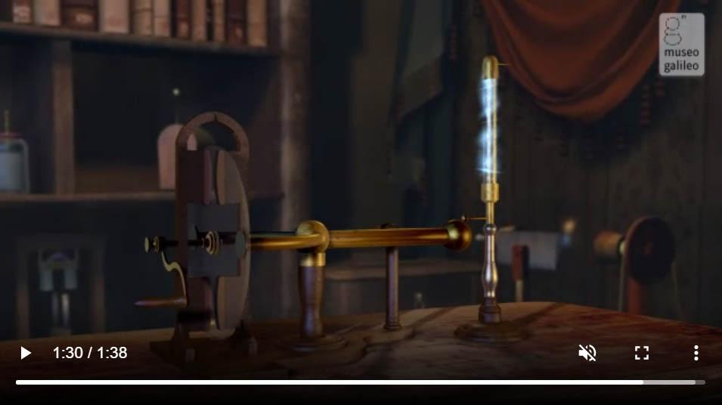
Electrical aurora
This glass tube generates a glow very similar to an aurora.
Watch the video
Notes:
IN-DEPTH
The video, its text transcription and some related instruments are available at https://catalogue.museogalileo.it/multimedia/ElectricalAurora.html

Slide 15
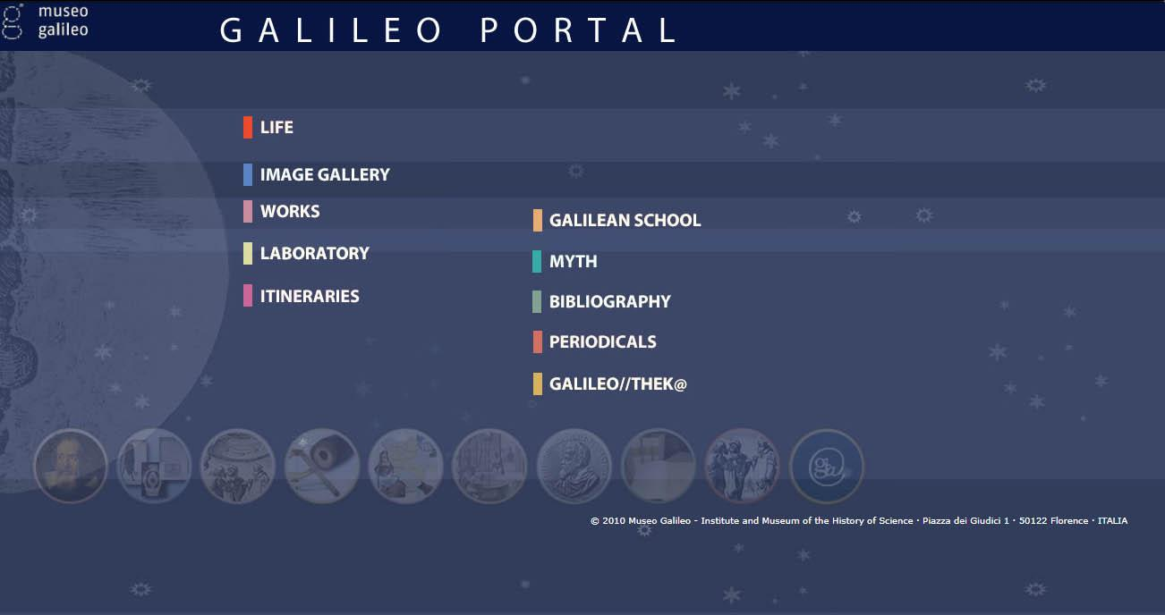
More about Galileo
To deepen the history of the man and the scientist consult the Galileo Portal at https://portalegalileo.museogalileo.it/index.html
Notes:
IN-DEPTH
For a short biography see also https://catalogue.museogalileo.it/biography/GalileoGalilei.html

