Slide 1
Galileo and the Celestial Phenomena
Pre-visit
(Middle school, age 11-13)
Notes:
INTRODUCTION
The lesson is structured to follow the inquiry system. At first, the student is involved in scientific questions to which he tries to answer, in a more exploratory phase, based on the experience and observation of the phenomenon. In this second phase, the teacher should only act as a facilitator, leaving students the opportunity to test their ideas and try to find a solution to problems in comparison with peers. Only later does the explanation phase arrive in which commonly accepted concepts and terminologies, that are useful for the interpretation of the evidence and the explanation of the phenomenon, are introduced.
In this document we use the section of the speaker notes (which are not projected during the lesson) to provide teachers with some annotations on the procedure to follow, suggestions to be inspired by, only in case the discussion reaches a stalemate, and links to a more extensive documentation on the subject, including references to the booklet in pdf which can later be given to students as an aid to review.

Slide 2
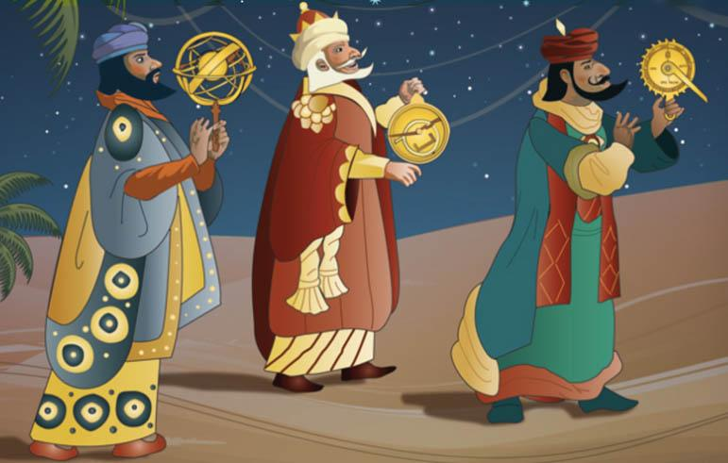
The importance of the sky in antiquity
Why was it important to observe the sky in ancient times?
How was the sky observed in antiquity and how did people imagine the Universe?
Notes:
INSTRUCTIONS FOR USE
Provoke a discussion starting from the suggested questions. Let students try to answer and share opinions. Check their current knowledge and help them try to see the sky from the point of view of ancient people.
SUGGESTIONS
1) Possible answers: religious and social functions, astrological beliefs, orientation purposes, to predict seasons and macro weather patterns for agricultural needs (i.e. the reappearance of the star Sirius, identified with the goddess Isis, in the constellation of Canis Major, announced the annual inundation of the Nile).
2) Man has always looked to the skies with both dread and expectation. The idea that the stars wield crucial influence over mankind was shared by all ancient civilisations. The universe was a space populated by divinities whose aspect, character and conduct were remarkably similar to those of mankind. While man has seen the planets as personifications of the gods, he has always identified the most visible groups of stars with animals and with familiar or imaginary figures. When interrogated according to the correct procedures, the heavenly vault could reveal an individual's fate, indicate the most propitious days for decisions affecting public and private life, foretell the astral configurations that announce crucial turning points in history, reveal the inclinations and practical aptitudes of an individual's character, show the influence that the planets and the signs of the zodiac have over the organs of the human body, and so on.

Slide 3
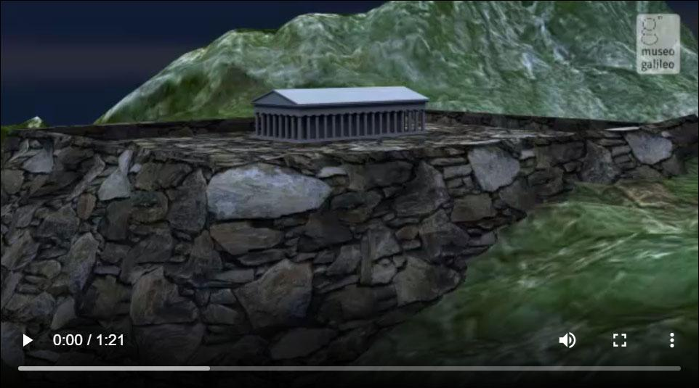
Pretelescopic astronomy
Some of the extraordinary results of naked-eye celestial observation in antiquity.
Watch the video
Notes:
IN-DEPTH
The video, its text transcription and some related instruments are available at https://catalogue.museogalileo.it/multimedia/PretelescopicAstronomy.html

Slide 4
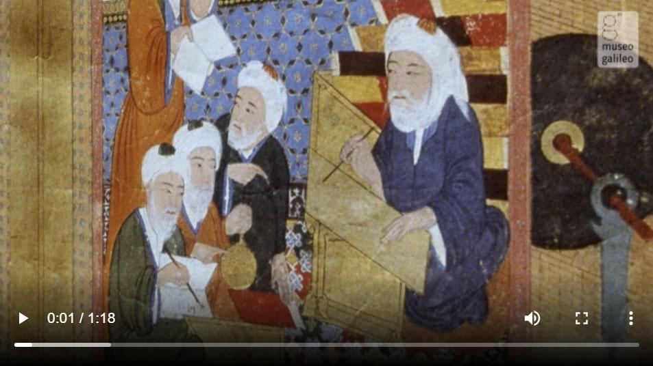
Arab astronomy
In the Arab world, the study of astronomy was of great importance because it was used for religious practices.
Watch the video
Notes:
IN-DEPTH
The video, its text transcription and some related instruments are available at https://catalogue.museogalileo.it/multimedia/ArabAstronomy.html

Slide 5
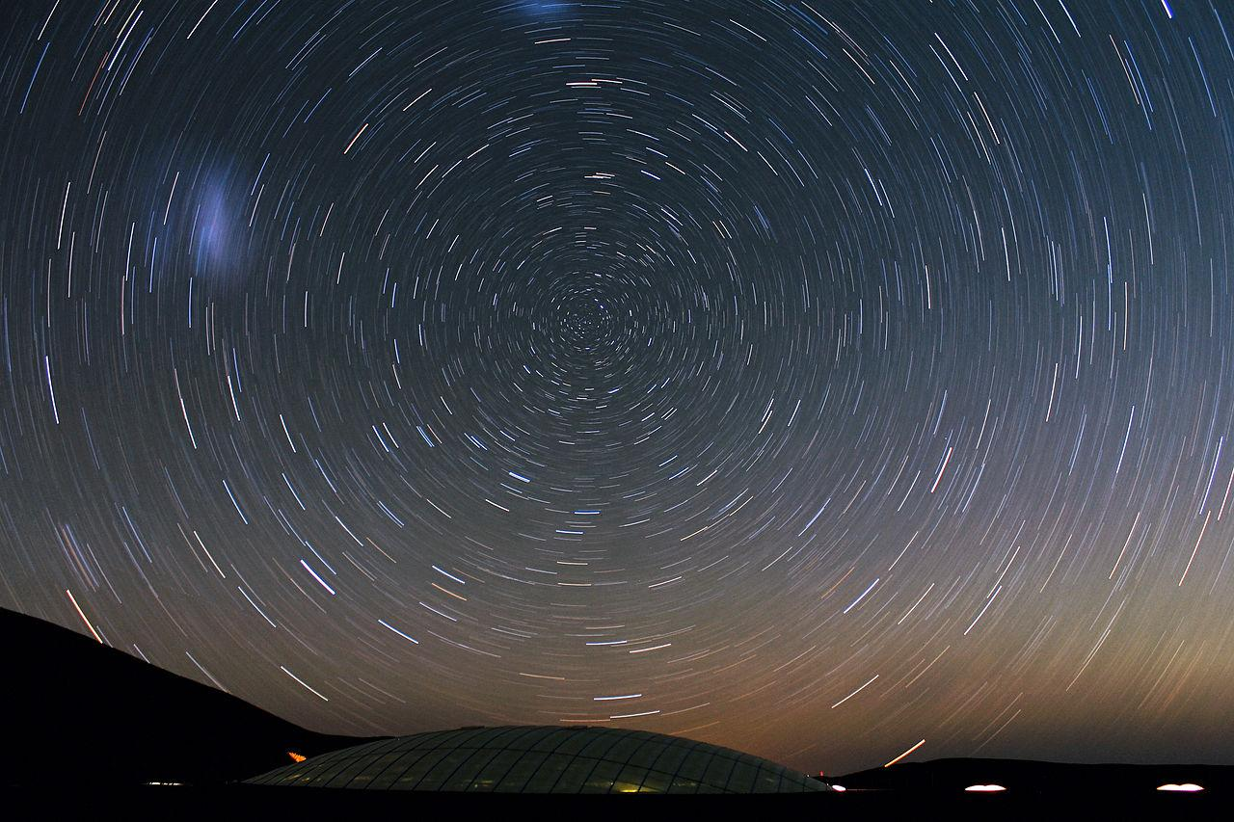
Astronomical observations
Have you ever stopped to observe the sky at night? What did you notice?
A wide variety of objects can be seen with the naked eye: which ones can you easily distinguish?
Do you know which planets are visible to the naked eye?
How do you tell a planet from a star?
Startrail.
CC BY 4.0 ESO/F. Char
Notes:
INSTRUCTIONS FOR USE
Start asking if anyone has ever made astronomical observations and if they have ever used a telescope. Let students confront their experiences and make them reflect on the challenges of observing the sky without modern means
SUGGESTIONS
1) The celestial sphere seems like a revolving dome with thousands of lights embedded in it. Do you know why? If you had lived in antiquity how would you have explained and represented it?
2) Examples of easily identifiable objects even without the help of an app: Sun, Moon, some of the brightest stars (we’ll see how to find the Pole Star and its importance during the visit and suggest some other stars for the post-visit phase), all planets of our Solar System with the exception of Uranus and Neptune and artificial objects.
3) Stars twinkle and planets don’t. There’s a difference also in the perceived movement: see slide 7

Slide 6
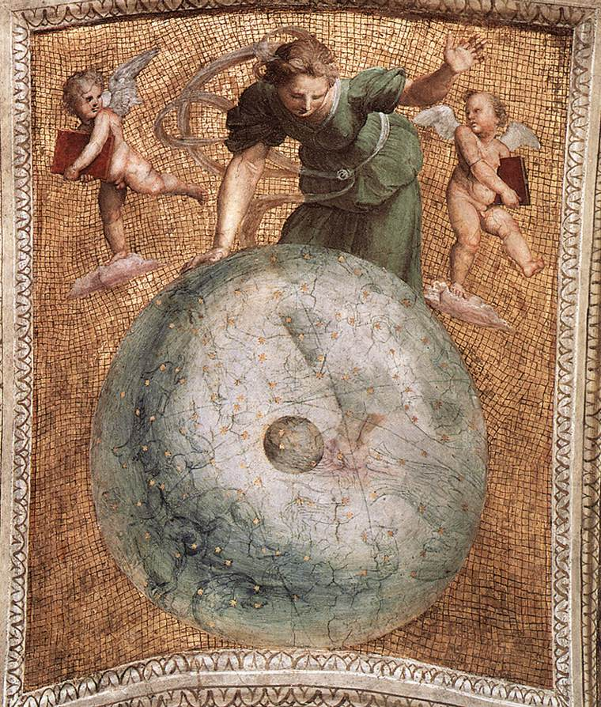
The Celestial Sphere as seen in antiquity
When we look at the sky on a clear night, the celestial bodies appear as points of light on an immense spherical vault centered on the observer: the celestial sphere.
There we can observe the two types of bodies: the fixed stars, whose relative positions do not change; and the moving stars—such as the planets—which, instead, move with respect to the fixed stars.
During the night, the celestial sphere seems to revolve on the terrestrial axis; this is an apparent motion, due to the rotation of the Earth.
Raffaello Sanzio, Prime Mover (ceiling panel), Stanza della Segnatura, Vatican Museums
Notes:
IN-DEPTH
EN_Galileo_Celestial_Phenomena_Pre-Visit_booklet_11-13.pdf, pp. 2-3

Slide 7
Astronomical observations: how to distinguish a planet from a star with the naked-eye
Both stars and planets appear as bright spots in the sky but…
Stars twinkle, planets don’t.
The planets rise in the east and set in the west, following a path similar to that of the Sun and the Moon. Therefore, if a celestial body appears to be moving in a straight line, it is more likely to be a planet.
If you observe the sky at night the stars tend to move in a circular pattern around the North Star.
Notes:
SUGGESTIONS
Planes and satellites are easily distinguished because they move faster.

Slide 8
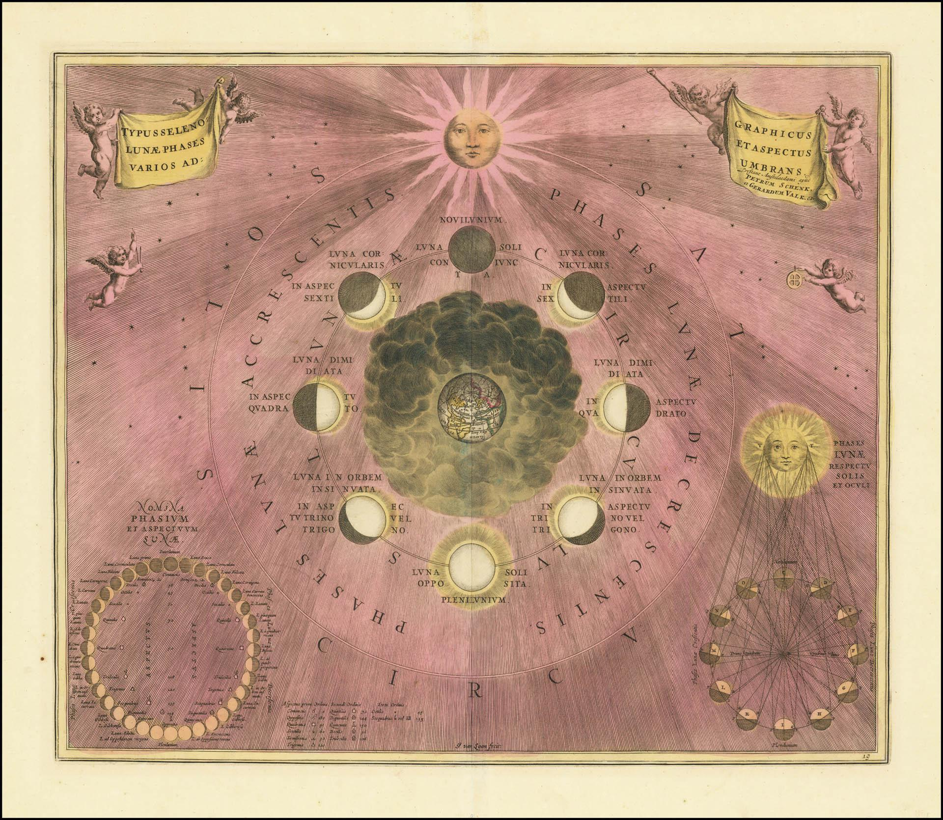
Astronomical observations: Lunar phases
One of the easiest celestial phenomena to observe.
There are four principal lunar phases:
New Moon
First quarter
Full Moon
Last quarter
During the new moon, the Moon is interposed between the Earth and the Sun, so the face visible from the Earth is completely in shadow and we cannot see it.
Andreas Cellarius, Atlas coelestis seu Harmonia Macrocosmica. Lunar phases
Notes:
SUGGESTIONS
You can take a cue from the slide to ask why, for example, the first quarter is also called the crescent moon (from the Latin verb crescere, to grow) or if the appearance of the phases in our hemisphere and in the southern one are identical. You could also have students observe the Moon for a few nights so that they find out what phase we are at (without using the Internet) and notice that, for an observer who is in the northern hemisphere like us, when the Moon is waxing the illuminated part of the lunar disk is on the right, while when it is waning it is on the left.
IN-DEPTH
EN_Galileo_Celestial_Phenomena_Pre-Visit_booklet_11-13.pdf, p. 6

Slide 9
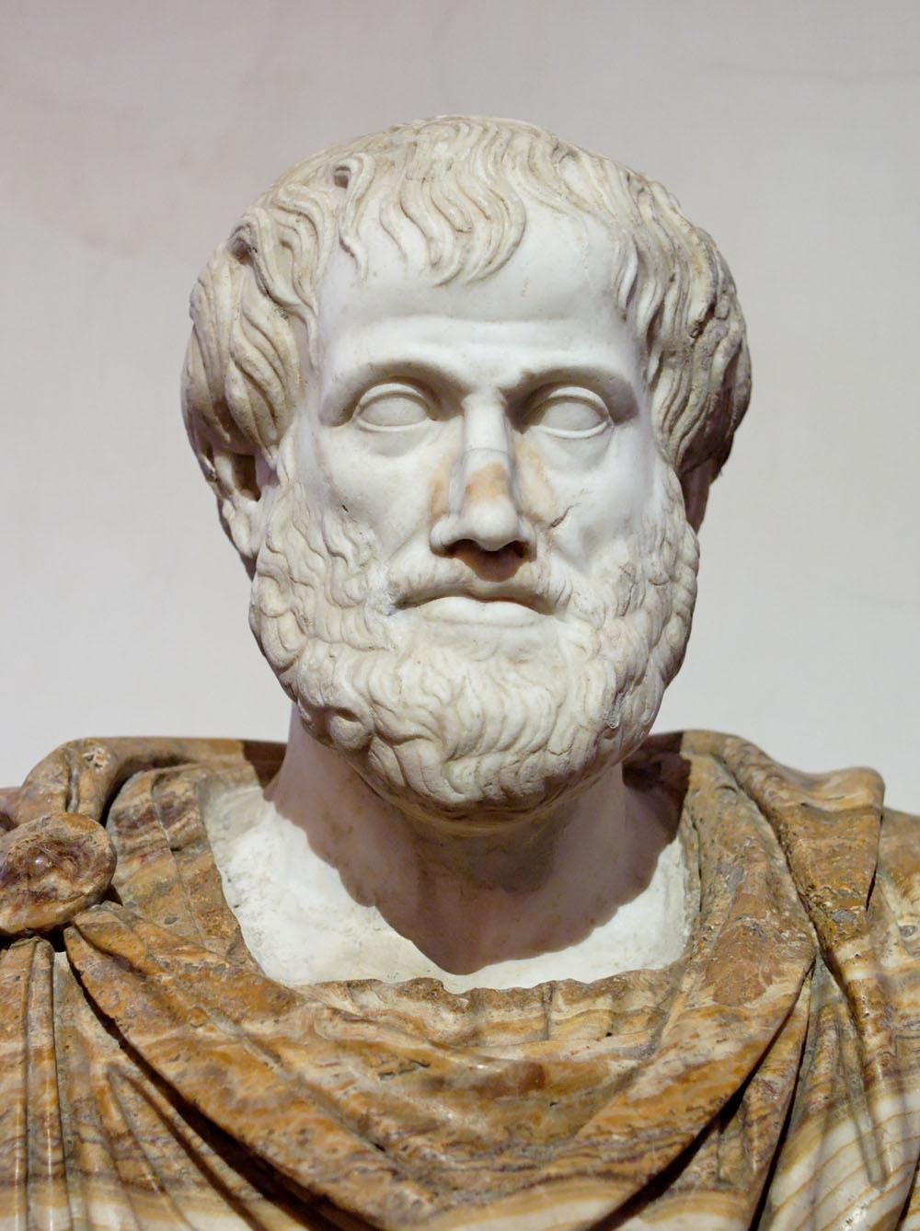
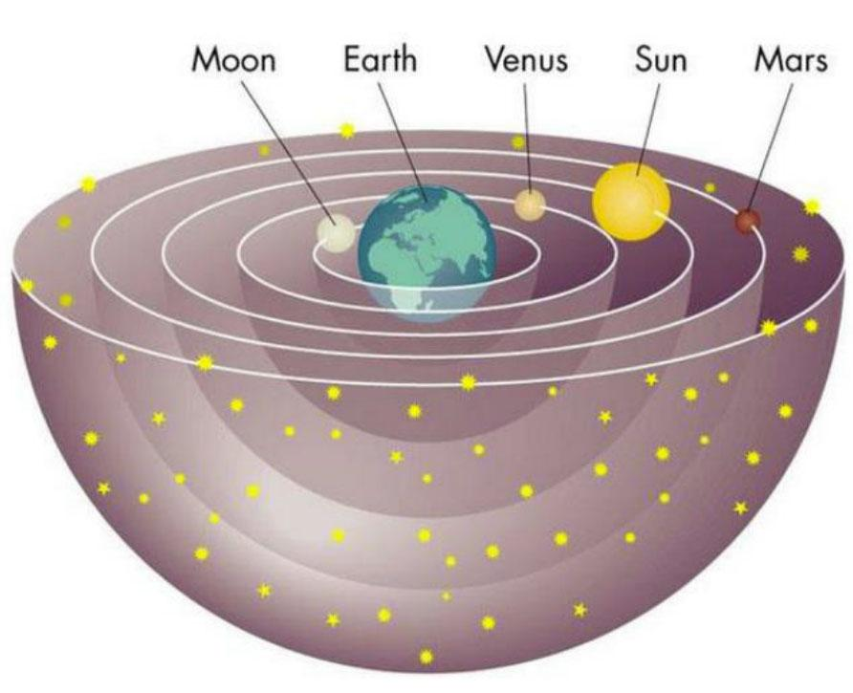
Aristotle
Aristotle (4th cent.BC) believed in a clear separation between Earth, a place of imperfection and corruption, and the celestial bodies, considered eternal and perfect .
He conceived the Earth at the centre of the Universe with all the other bodies embedded in crystalline spheres revolving around it.
Bust of Aristotle. Palazzo Altemps, Rome
Notes:
IN-DEPTH
EN_Galileo_Celestial_Phenomena_Pre-Visit_booklet_11-13.pdf, p. 7

Slide 10
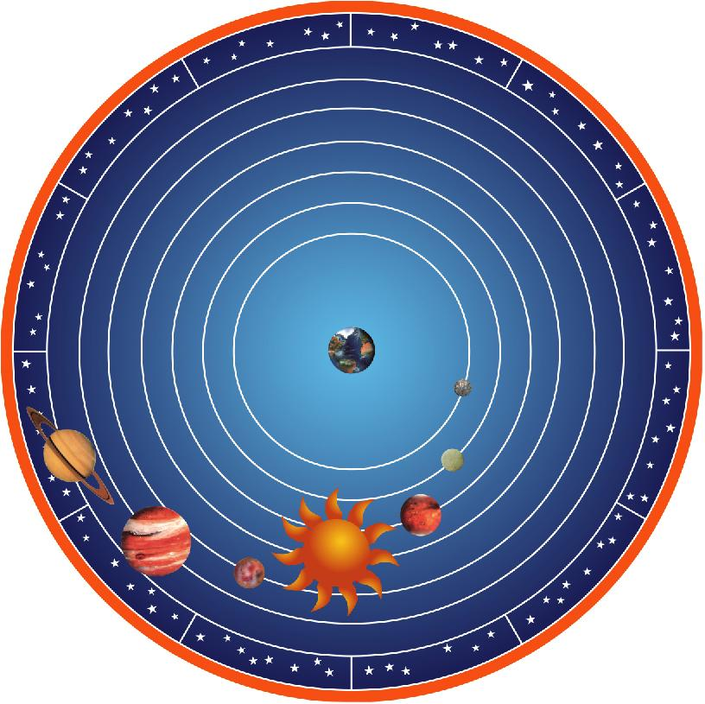
The Geocentric System
Under the geocentric model all celestial bodies orbit Earth following this order:
Moon
Mercury
Venus
Sun
Mars
Jupiter
Saturn
fixed stars located on the celestial sphere
Model of the geocentric system. Museo Galileo, Florence
Notes:
IN-DEPTH
EN_Galileo_Celestial_Phenomena_Pre-Visit_booklet_11-13.pdf, pp. 4-5

Slide 11
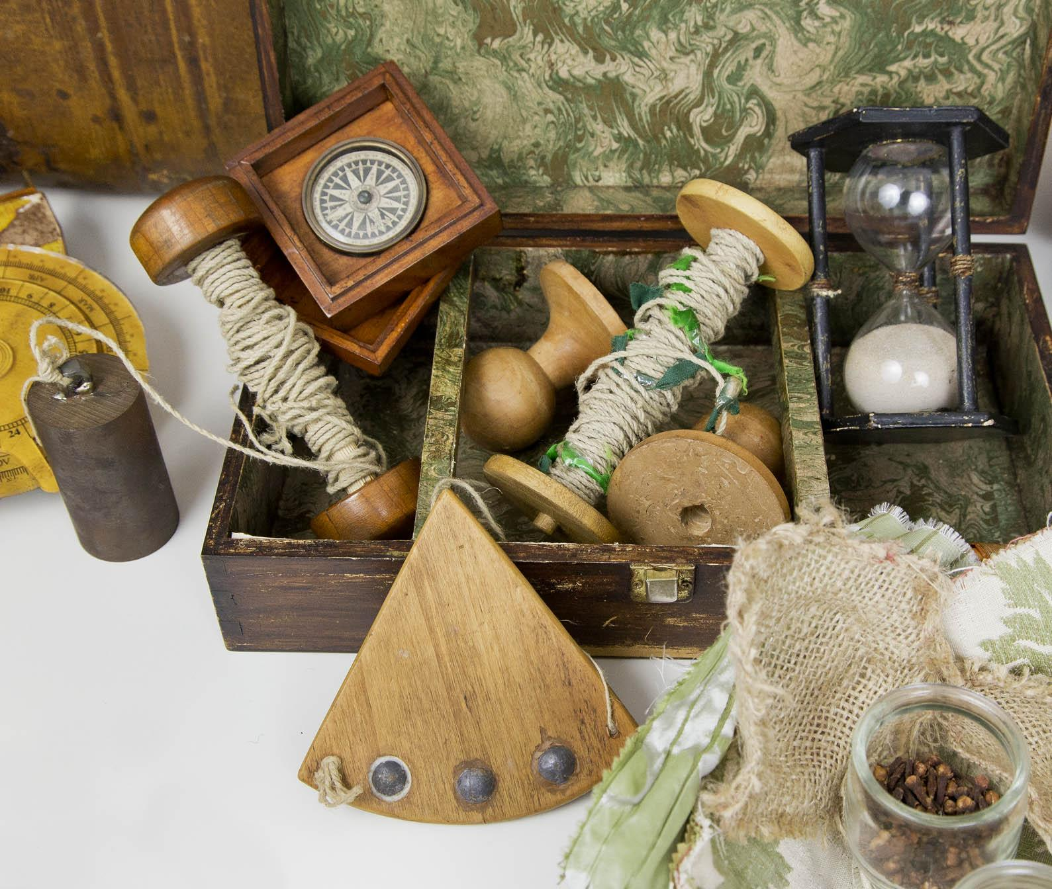
Orientation problems
How do we reach a place we haven’t been before?
Can you orient yourself without GPS? What can you use?
Instruments for navigation. Museo Galileo, Florence
Notes:
INSTRUCTIONS FOR USE
Ask students if they have ever been lost and what they have done to orient themselves. Without the help of cell phones or satellite navigators, how would they do it?
SUGGESTIONS
This discussion serves to provoke a first reflection on the difficulties of orienting oneself without modern means and the usefulness of celestial observations.
It will also lead to the discovery of ancient instruments, like the astrolabe, that will be explained during the visit

Slide 12
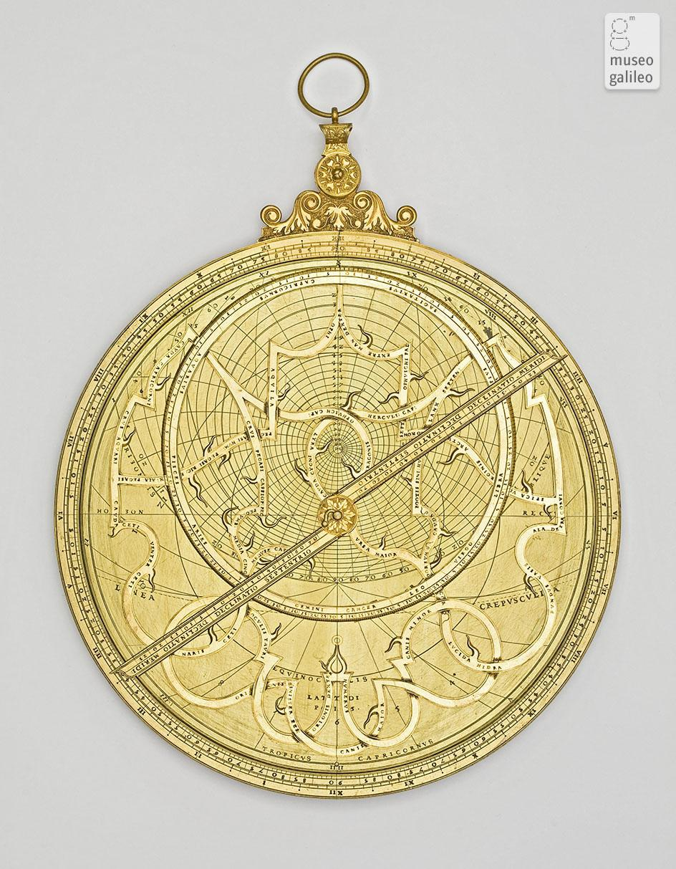
The Astrolabe
The planispheric astrolabe is the most important and versatile instrument made in antiquity for the analogical performance of astronomical computations that would otherwise have been long and complex.
For example, it was used to calculate the position of a star or the time of day.
Christoph Schissler, Plane astrolabe (1560). Museo Galileo, Florence
Notes:
IN-DEPTH
EN_Galileo_Celestial_Phenomena_Pre-Visit_booklet_11-13.pdf, p. 8

Slide 13
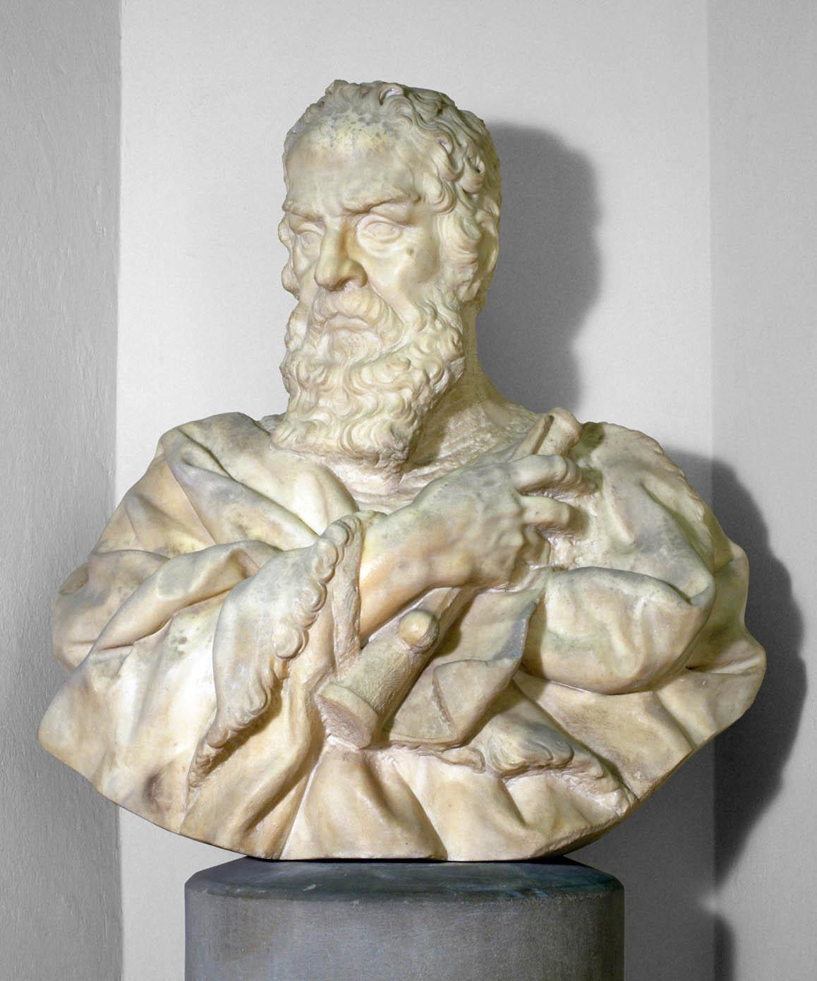
A New World
Do you know this man?
What do you know about his life?
Notes:
INSTRUCTIONS FOR USE
The purpose of these questions is only to find out what the students know about Galileo and provoke their curiosity on the subject.
SUGGESTIONS
Galileo, as well as his revolutionary discoveries, methodology, instruments and his works, will be at the core of the visit, so it is not necessary to elaborate further.
More material will be suggested for the post-visit phase.
Image: Carlo Marcellini, Bust of Galileo Galilei. Museo Galileo, Florence

Slide 14
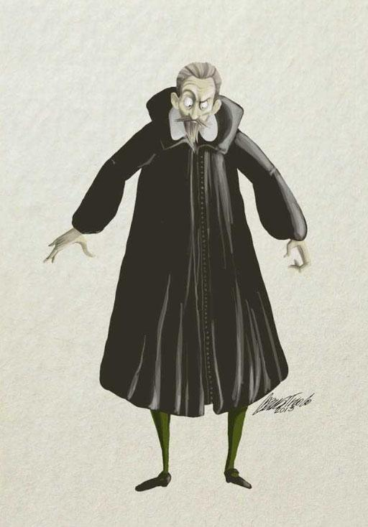
Galileo Galileo
Identity Card
Name: Galileo Galilei
Date of Birth: February 15, 1564
Place of Birth: Pisa, Italy
Identifying Marks: Very curious experimenter and observer of the Universe
Being a professor, Galileo was obliged to wear a long toga. These robes served the purpose of conveying the person’s status.
Illustration by Elena Triolo. Museo Galileo, Florence
Notes:
INSTRUCTIONS FOR USE
Galileo, his revolutionary discoveries, methodology and instruments will be the core part of the visit and the post-visit, so in this phase is not necessary to deepen the subject.
SUGGESTIONS
For a short biography see also https://catalogue.museogalileo.it/biography/GalileoGalilei.html

