Slide 1
Galileo’s New World
Pre-visit
(Primary and Middle schools, age 9-13)
Notes:
INTRODUCTION
The lesson is structured to follow the inquiry system. At first, the student is involved in scientific questions to which he tries to answer, in a more exploratory phase, based on the experience and observation of the phenomenon. In this second phase, the teacher should only act as a facilitator, leaving students the opportunity to test their ideas and try to find a solution to problems in comparison with peers. Only later does the explanation phase arrive in which commonly accepted concepts and terminologies, that are useful for the interpretation of the evidence and the explanation of the phenomenon, are introduced.
In this document we use the section of the speaker notes (which are not projected during the lesson) to provide teachers with some annotations on the procedure to follow, suggestions to be inspired by, only in case the discussion reaches a stalemate, and links to a more extensive documentation on the subject, including references to the booklet in pdf which can later be given to students as an aid to review.

Slide 2
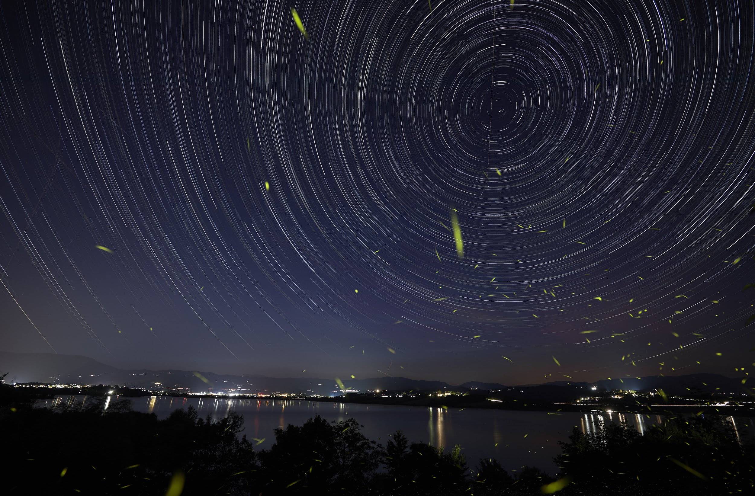
Watching the sky
Have you ever made any astronomical observation?
What does the sky look like at night?
Startrail. Marco Berni
Notes:
INSTRUCTIONS FOR USE
Provoke a discussion starting from the suggested questions. Let students try to answer and share opinions. Check their current knowledge and help them try to see the sky from the point of view of ancient people.
SUGGESTIONS
1) The first question is to engage the students. It is a proven fact that the lesson, to be effective, must be contextualized in a world recognizable by the students and involve their personal interests and passions. This is one of the pillars of IBSE
2) It looks like an hemispheric cap that rotates in about 24 hours around a fixed point. The relative position between the stars does not seem to change, and it is not possible to perceive the different distance from the Earth of all those bright points, so it is easy to imagine how the ancients thought that the stars were embedded on a sphere that rotated around our planet.

Slide 3
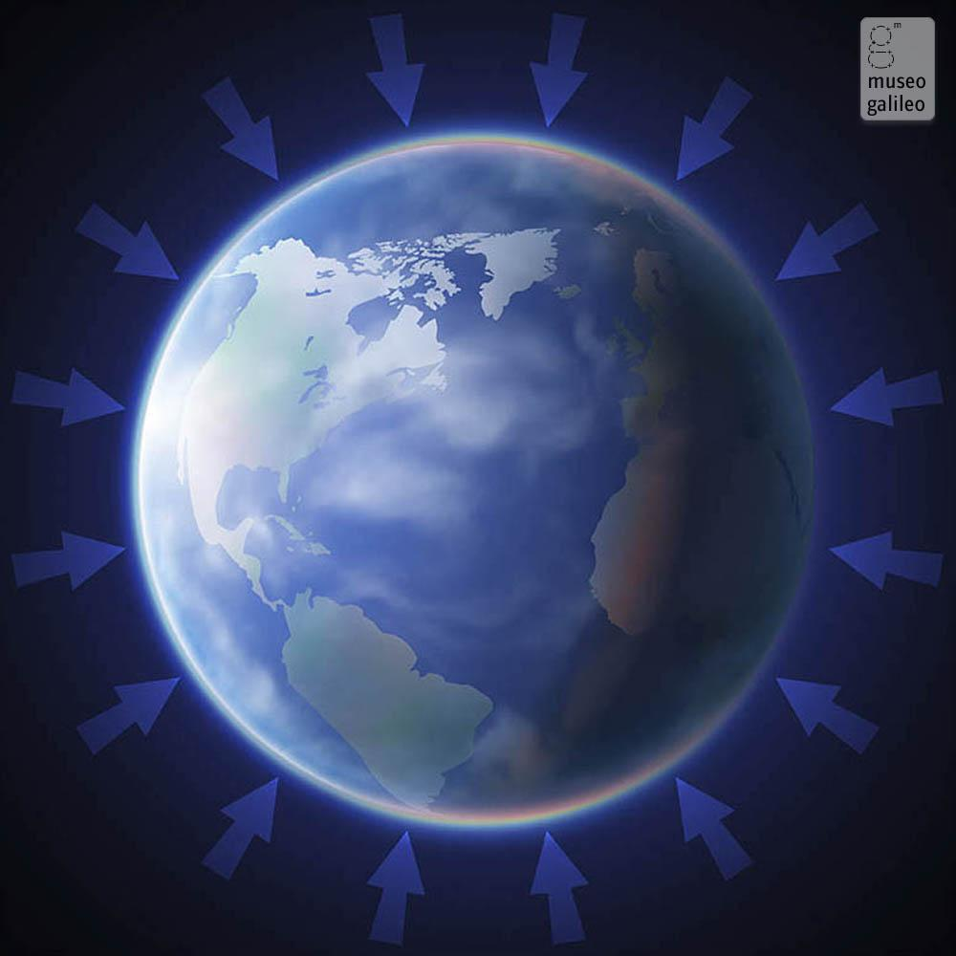
Spinning, spinning ...
If we look at the sky at night why do we see the stars and planets moving?
Why don’t we fly off?
Notes:
SUGGESTIONS
1) In reality it is the Earth that rotates on its own axis. We do not perceive the rotation because we also move with the planet. To understand better, let's think of a train journey: when we look out the window of a moving train we have the sensation of being stationary while the landscape flows quickly backwards. In reality it is the train that moves with us on it.
2) Due to the force of gravity. It is said that a British scientist, named Isaac Newton, one day was in his garden when an apple fell on his head. Wondering why, Newton thought that there must be an invisible force that attracted the apple to the Earth and called this force "gravity", from the Latin word "gravitas", which means "weight". Every object in the universe that has a mass exerts a gravitational pull on any other type of mass. The strength of gravity, however, depends on the mass of an object. Gravity has effects that are only visible when one object is much larger and heavier than the other and they are close enough to each other. Since the gravity of the little apple is too weak to resist the pull exerted by the Earth, it falls towards the center of the planet. The gravitational pull of an object decreases as you move away from it. A climber on top of Mount Everest weighs a little less than he weighs at sea level. If a spacecraft travels far from Earth, it will eventually escape its attraction altogether.

Slide 4
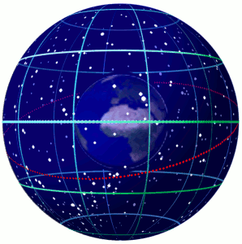
The Earth like a Spinning Top
At night, the stars seem to revolve uniformly around a fixed point.
The daily movement of the celestial bodies in the sky is caused by the rotation of the Earth on its axis.
The planets appear to rise in the east and set in the west, tending to follow a similar path to that of the Sun and the Moon.
If you observe the sky at night, the stars tend to move in a circular pattern around the North Star.
Earth spinning within a celestial sphere.
CC BY-SA 3.0 Tfr000
Notes:
IN-DEPTH
EN_Galileo_New_World_Pre-Visit_booklet_9-13.pdf, p. 2-4

Slide 5
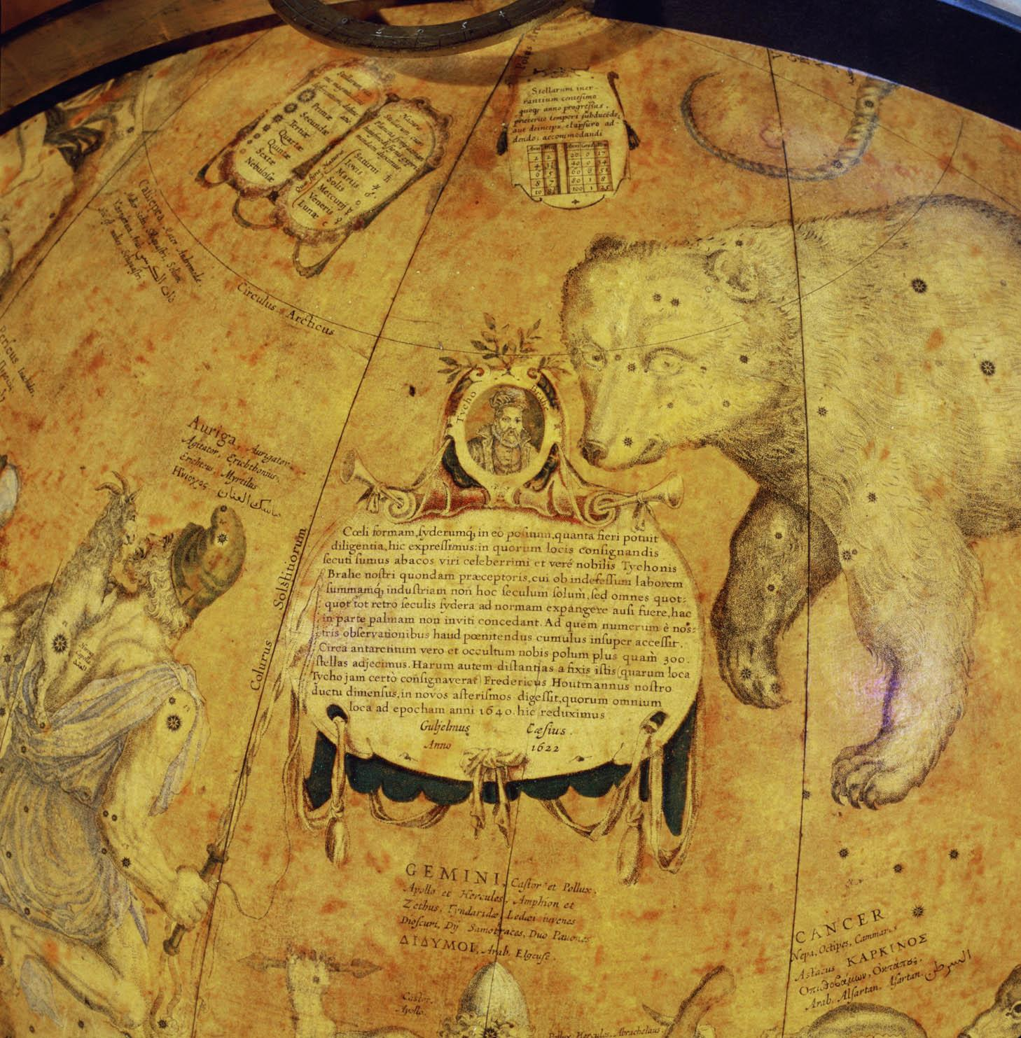
Watching the sky
How ancients represented the sky?
What do you know about constellations?
Have they always been the same?
Do they have scientific validity and what are they for?
Celestial globe by Jansz Willem Blaeu. Museo Galileo, Florence
Notes:
INSTRUCTIONS FOR USE
Help students try to understand what ancient people could feel and imagine by looking at the celestial vault without the knowledge and means we have today. How could the sky be represented?
SUGGESTIONS
1) Observing the sky the ancients saw an immense expanse of stars that seem "attached" to the celestial vault and that all rotated together, in a uniform way, maintaining mutual distances. It was therefore natural that they thought that these bright spots were all at the same distance. The brightest stars were grouped into constellations.
2) It was common, among different cultures, to bring the brightest stars together in groups to form figures. So, at some point in time, the sky begins to populate with fabulous creatures, heroes and mythological animals. But, since the grouping operation is purely arbitrary, each culture, each tribe has built its own figures and has given them different names and histories according to their traditions. So different civilizations have created different constellations. However some constellations, due to the ease of identifying them, are common. For example the Greek constellation of the Ursa Major represented the god Tezcatlipoca for the Aztecs, and its seven main stars were the “Septem Triones“ for Roman because, their rotation around the North Star recalled the movement of oxen (triones) during plowing.
The truth is that the constellations are nothing more than groupings of stars that seem close to each other only for perspective reasons, but that in reality are enormously distant.
The grouping of stars into constellations served and still serves the purpose to quickly recognize individual stars and therefore orient oneself in the starry sky.

Slide 6
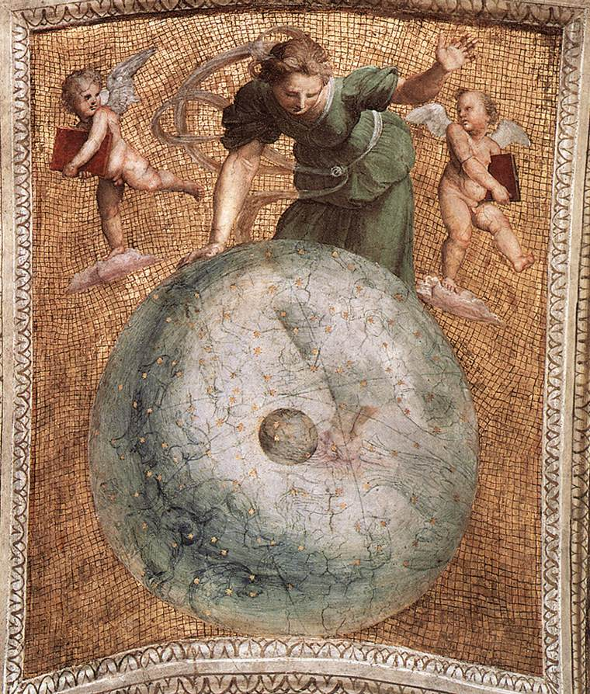
The Celestial Sphere as seen in antiquity
In ancient times, the stars on the celestial vault were always represented as they would appear to someone observing the celestial sphere from the outside.
The brightest stars were grouped together to form figures, the constellations.
The stars of the Zodiac (from the Greek word zòon which means animal / living being) are groups of stars representing real or fantastic living beings that are found along the apparent path of the Sun in its annual motion.
Raffaello Sanzio, Prime Mover (ceiling panel), Stanza della Segnatura, Vatican Museums
Notes:
IN-DEPTH
EN_Galileo_New_World_Pre-Visit_booklet_9-13.pdf, pp. 2-4

Slide 7
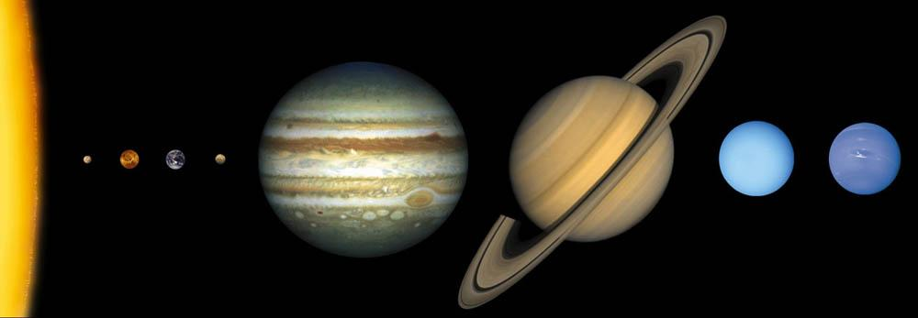
The Solar System
Can you tell the planets of our solar system in the right order starting from the Sun? In the image below there is an error. Can you tell which one?
How did the ancients imagine it and why?
Notes:
INSTRUCTIONS FOR USE
This is not the focus of the visit, but starting from current knowledge the discussion will be more engaging for students. It is also an easier and safer way for teachers to introduce the geocentric model avoiding misconceptions.
SUGGESTIONS
1) The error mentioned is obviously the relative distance between planets and the fact that planets are never aligned this way. Due to the models and the images available in books, children often have a wrong idea of proportions and distances.
2) Reconnect to the image of the train (suggestion 1 in slide 3) to make people understand how the idea of the stationary Earth at the center of the Universe was the easiest one to imagine.

Slide 8
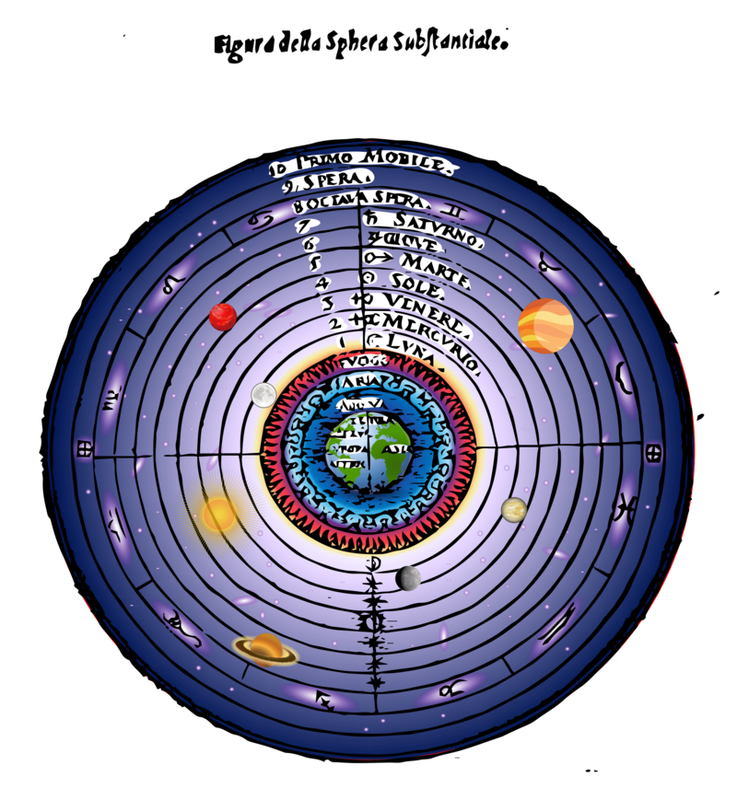
The cosmological model in antiquity
The ancients imagined the Earth was at the center of the Universe.
An ancient greek philosopher, Aristotle (4th century BC), believed that the Earth was composed of the four elements (earth, water, air and fire) and that all celestial bodies orbited around it.
In the geocentric system the celestial bodies followed this oder: Moon, Mercury, Venus, Sun, Mars, Jupiter, Saturn and the fixed stars located on the celestial sphere.
The celestial spheres in the geocentric view of the universe.
CC BY-SA 4.0 Alvaro Marques Hijazo

Slide 9
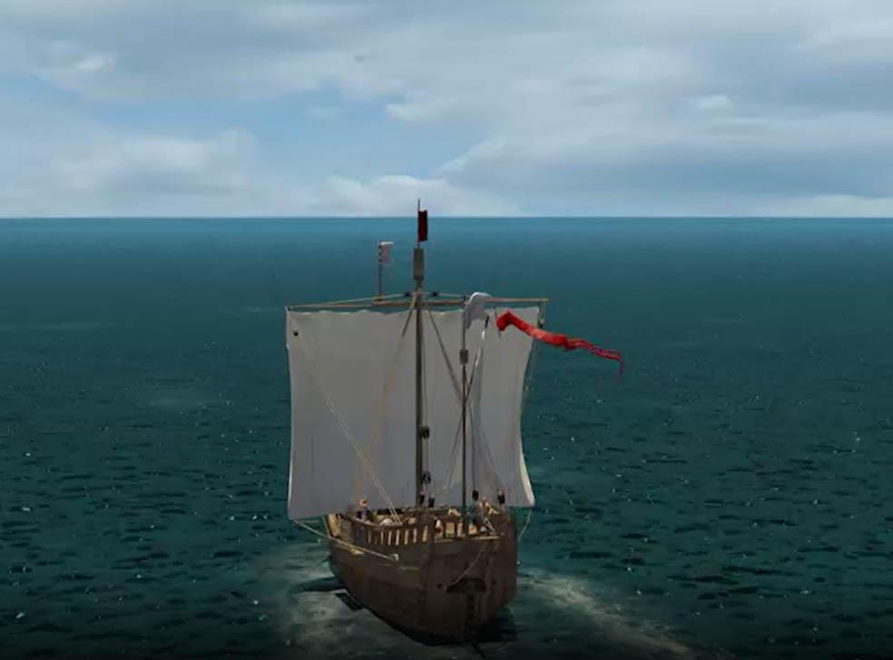
How do we orient ourselves?
How do we determine a point on the Earth's surface?
Do you know any reference point? What are they for?
Notes:
INSTRUCTIONS FOR USE
During the visit we will be introduced ancient instruments which, using the position of some celestial bodies, were used for orientation purposes and to calculate the time of day and night. Introducing the Earth coordinate system in the classroom will help to understand the basic concepts of the celestial ones.
SUGGESTIONS
Basic introduction to geographic coordinates. In order to be able to indicate a point on the Earth's surface, geographers have "covered" the Earth with an imaginary grid made up of horizontal and vertical lines. The horizontal lines are called parallels and are counted, either towards the north or towards the south, starting from the central one, the Equator. They are used to measure latitude.
The equator cuts the Earth into two equal halves: the northern hemisphere, and the southern hemisphere. Other special parallels (such as the Tropic of Cancer and the Arctic Pole in the north, and the Tropic of Capricorn and the Antarctic Pole in the south) serve to define Earth's climatic zones. The reference parallels are 180 (90 north and 90 south of the equator)
The vertical lines are called meridians and are counted starting from the zero meridian passing through Greenwich. They are counted either to the east or to the west and indicate the longitude.The reference meridians are 360 (180 east and 180 west of Greenwich)

Slide 10
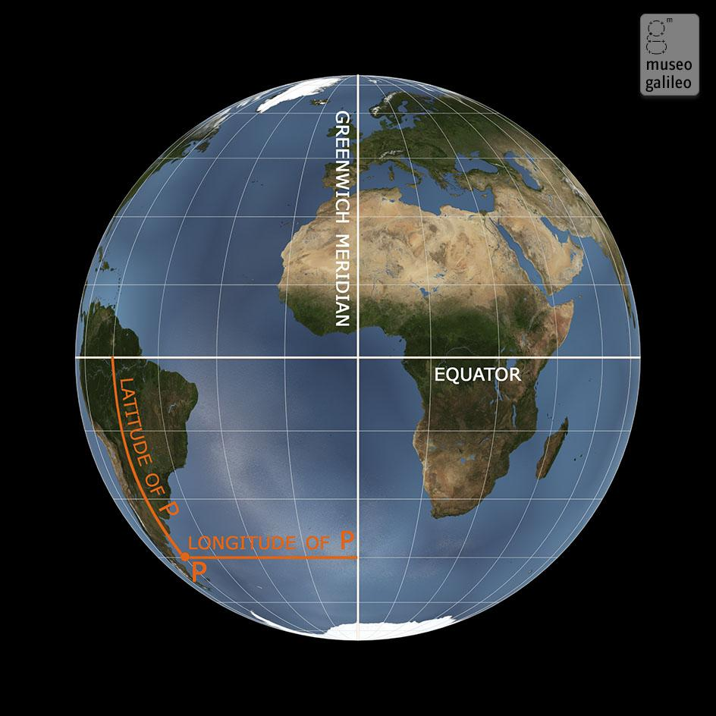
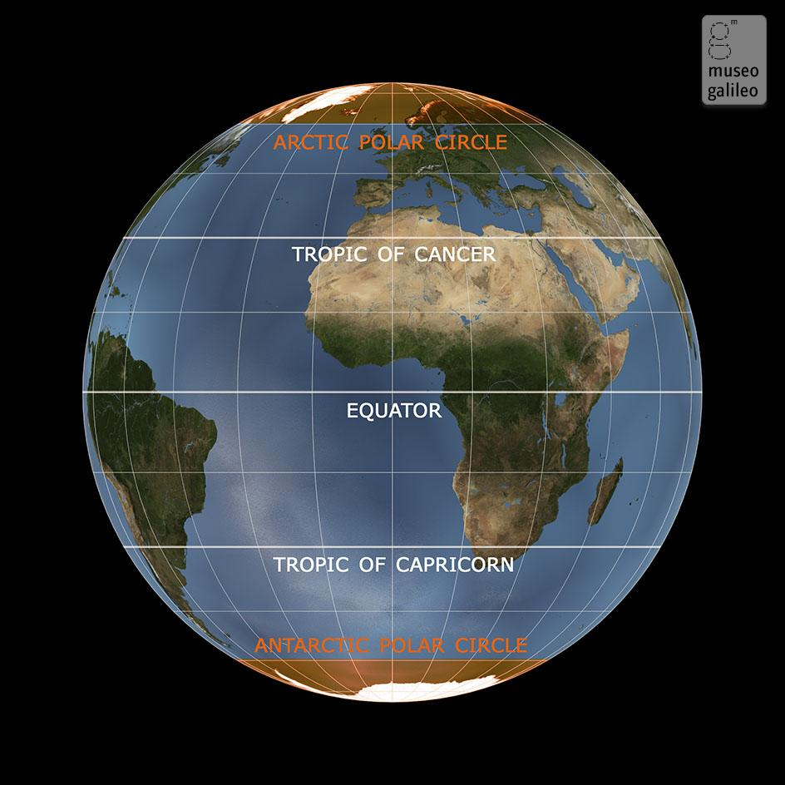
The geographic coordinate system
Longitude and latitude. Museo Galileo, Florence
The main Parallels. Museo Galileo, Florence

Slide 11
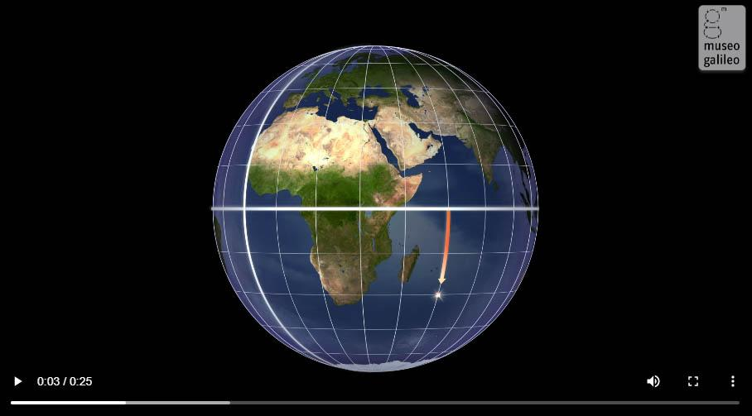
Latitude
Latitude measures the distance of a point from the Equator.
Watch the video
Notes:
IN-DEPTH
The video, its text transcription and some related topics are available at https://mostre.museogalileo.it/framauro/en/land-and-sea/latitude.html

Slide 12
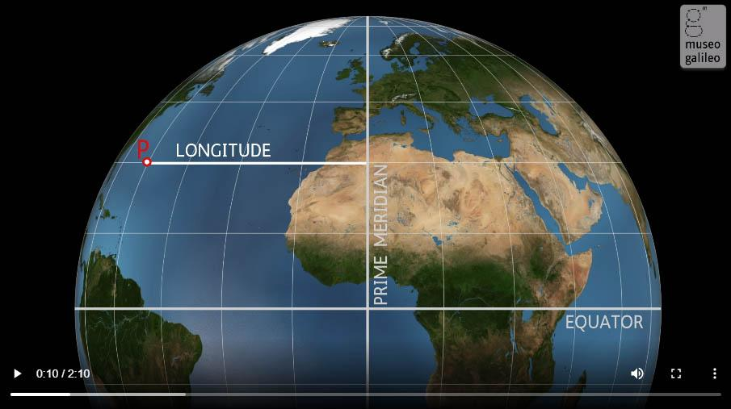
Longitude
Longitude measures the distance of a point from the reference meridian.
Watch the video
Notes:
IN-DEPTH
The video, its text transcription and some related topics are available at https://mostre.museogalileo.it/framauro/en/land-and-sea/longitude.html

Slide 13
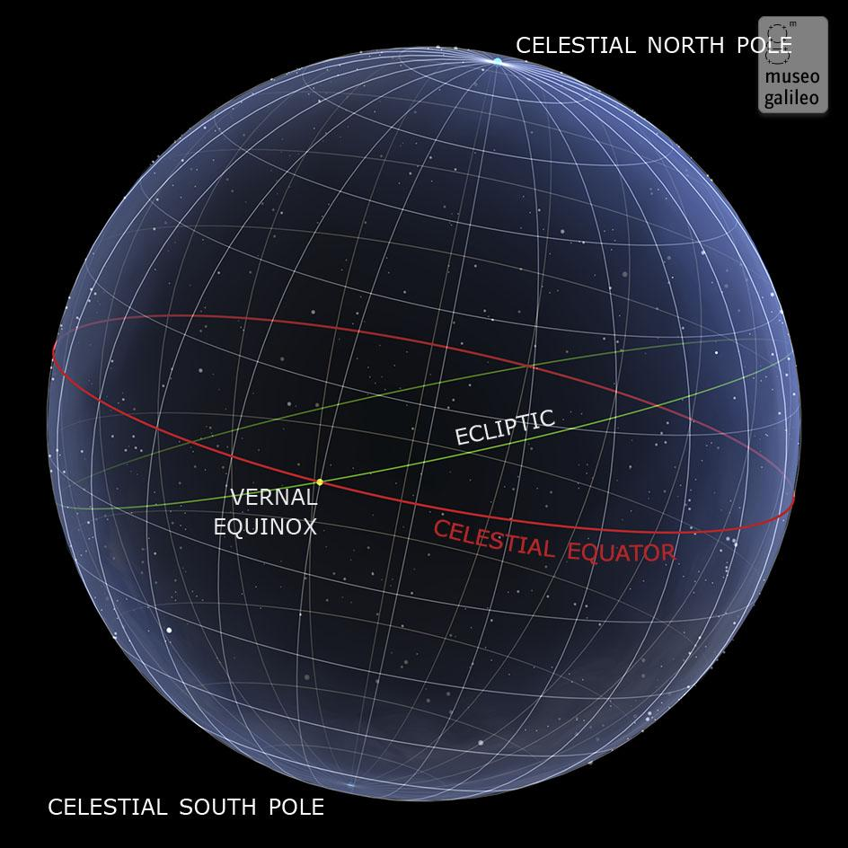
Equatorial coordinates
Similar to the Earth coordinate system, a grid of horizontal and vertical lines projected onto an imaginary celestial sphere is used to identify the position of a celestial body.
Equatorial coordinates. Museo Galileo, Florence
Notes:
IN-DEPTH
EN_Galileo_New_World_Pre-Visit_booklet_9-13.pdf, p. 8

Slide 14
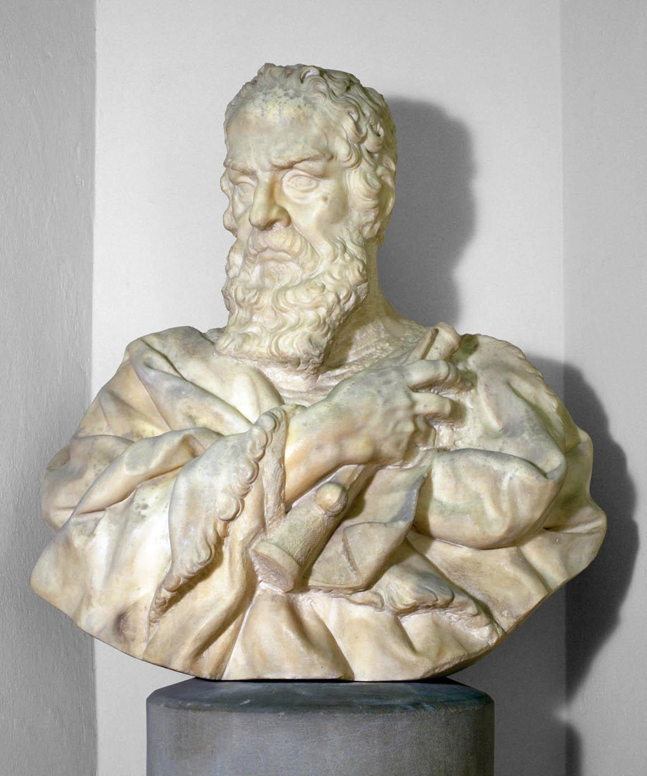
A New World
Do you know this man?
What do you know about his life?
Notes:
INSTRUCTIONS FOR USE
The purpose of these questions is only to find out what the students know about Galileo and provoke their curiosity on the subject.
SUGGESTIONS
Galileo will be at the core of the visit, so it is not necessary to elaborate further
More material will be suggested for the post-visit phase.
Image: Carlo Marcellini, Bust of Galileo Galilei. Museo Galileo, Florence

Slide 15
Galileo Galileo
Born in Pisa on February 15, 1564, Galileo is considered the father of modern science for a number of reasons:
the importance of his astronomical discoveries
his intuitions about the motion of bodies
his idea and ability to demonstrate experimentally the direct observation of phenomena
His life also inspired and fascinated writers and film directors because he is a symbol of the contrast between science and faith and between freedom of thought and political and religious authority.
Notes:
IN-DEPTH
EN_Galileo_New_World_Pre-Visit_booklet_9-13.pdf, pp. 9-10

